Slide 1
YouTube Ad Revenue Prediction Using Machine Learning
End-to-End ML Project: EDA → Feature Engineering → Modeling → Deployment

Slide 2
Project Objective
The goal of this project is to build a machine learning model to predict YouTube Ad Revenue (USD) based on video metrics.
This helps creators estimate earnings before upload using features like:
Views
Likes
Comments
Watch Time
Video Length
Subscribers
Device, Category, Country
Upload time features

Slide 3
Dataset Summary
122,400 rows
15 columns initially
7 numerical + 5 categorical + 3 data fields
Key features include:
Views
Likes
Comments
Watch Time Minutes
Video length minutes
Subscribers
Category
Device
Country
Ad revenue usd

Slide 4
Data Preprocessing
Steps Performed:
Removed duplicate records
Handled missing values using median imputation
Converted date columns to datetime format
Extracted time-based features:
  upload_year
  upload_month
  upload_day
  upload_hour
  upload_weekday
One-hot encoded categorical variables
Result:
Clean and model-ready dataset

Slide 5
EXPLORATORY DATA ANALYSIS (EDA)
Key Insights from EDA:
Watch time has a very strong correlation with ad revenue (~0.99)
Views, likes, and comments show weak correlation
Revenue is primarily driven by viewer retention
Dataset has minimal outliers
Conclusion:
Watch time is the most important predictor of ad revenue

Slide 6
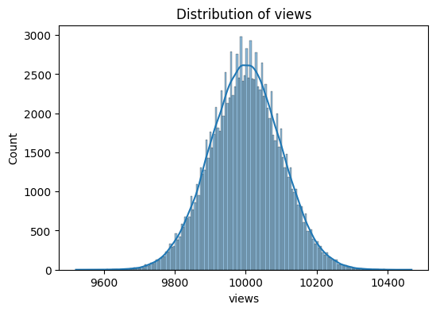
Views distribution is normally shaped, centered around 10,000. This indicates clean, consistent data without outliers suitable for regression modeling.

Slide 7
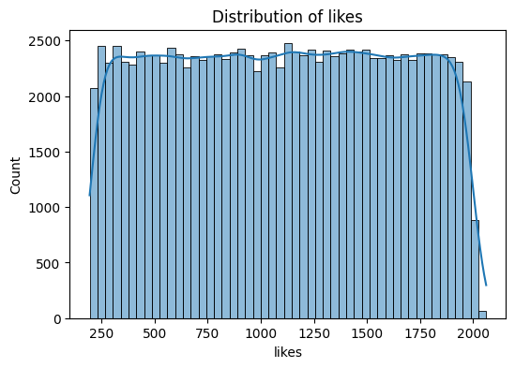
Likes shows a uniform distribution, indicating varied engagement across videos. No major skew or outliers detected.

Slide 8
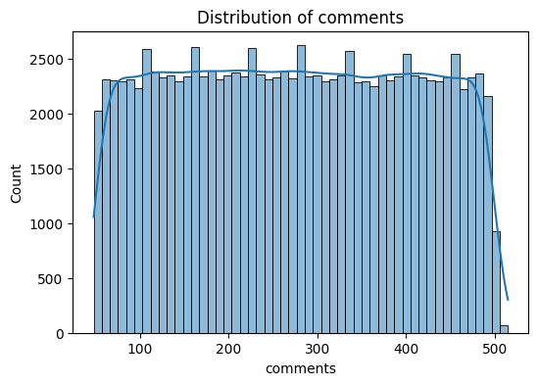
Comments are uniformly distributed with no major skew, indicating consistent audience interaction patterns.

Slide 9
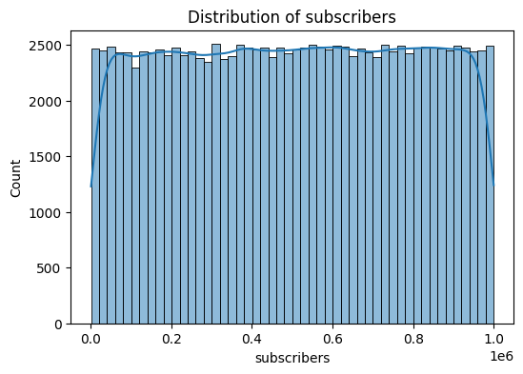
Subscribers range from very small channels to creators with 1M+ subscribers. The uniform distribution helps the model learn revenue behavior across channel sizes.

Slide 10
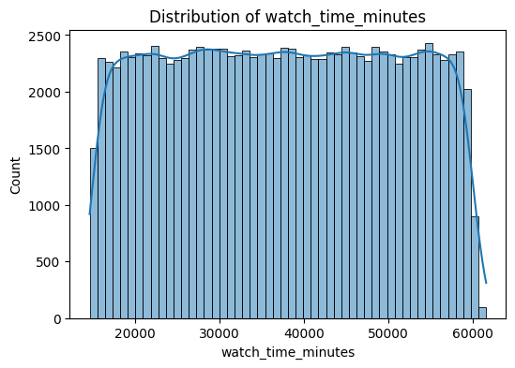
Watch time is uniformly distributed across videos, with values ranging from 15,000 to 60,000 minutes. There is no significant skew or outliers, indicating that watch time varies naturally across content types.

Slide 11
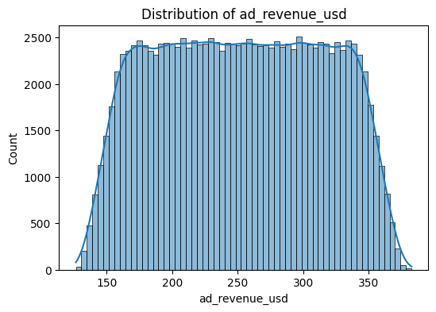
Ad revenue values are uniformly distributed between 140 and 380 USD. There is no skew or extreme outliers, suggesting stable revenue behavior across videos.

Slide 12
Scatter Plot Insights
Views vs Revenue → No correlation due to limited variation in views.
Watch Time vs Revenue → Strong positive linear relationship.

Slide 13
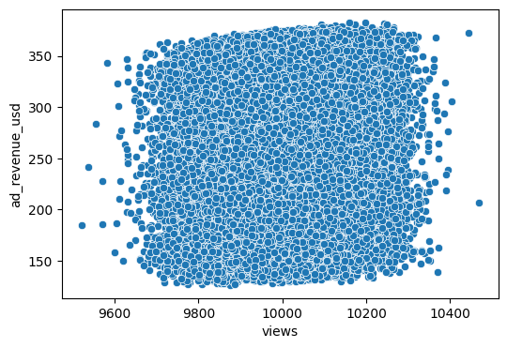
The scatter plot of views vs revenue shows no clear relationship. Views are almost constant for all videos, so they do not significantly affect revenue in this dataset.

Slide 14
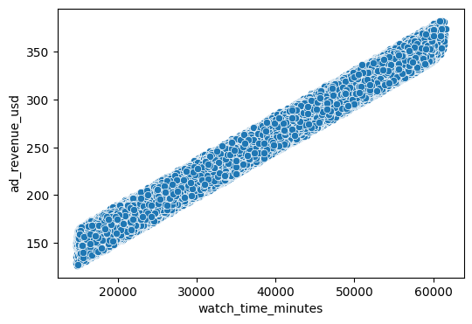
Watch time shows a very strong positive linear relationship with ad revenue. Videos with higher watch time consistently generate higher revenue. This makes watch time most important predictor in the dataset.

Slide 15
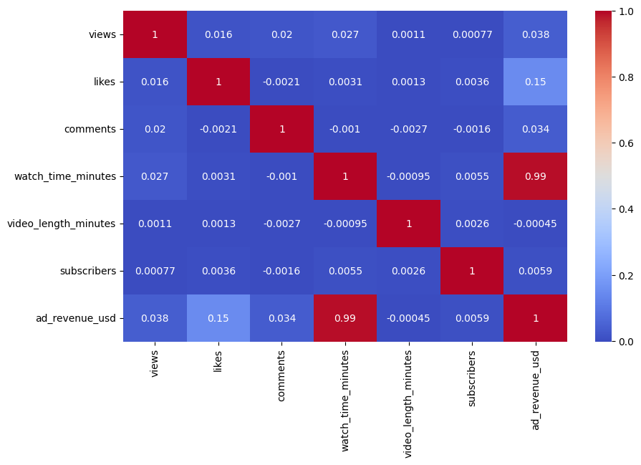
Correlation Heatmap

Slide 16
Insights
Watch time minutes shows a very strong positive correlation (0.99) with ad revenue usd.
Likes, comments, and views show weak or nearly zero correlation with revenue.
Subscribers and video length also have almost no relationship with revenue.
This confirms that watch time is the most important feature for predicting ad revenue.

Slide 17
Feature Engineering Performed
Data based features:
upload_year, upload_month, upload_day, upload_hour, upload_weekday
One-hot encoding:
category, device, country
Removed the original date columns
Final feature count: 32 columns

Slide 18
Modeling Approach
Models Used:
Linear Regression
Decision Tree Regressor
Random Forest Regressor
Train/Test Split:
80% train (96,000 rows)
20% test (24,000 rows)

Slide 19
Model Performance Comparison
Model | RMSE | R² Score
Linear Regression | 0.6118 | 0.9999
Decision Tree | 0.3123 | 1.0000
Random Forest | 0.1497 | 1.0000

Slide 20
Observation
All models performed extremely well
Linear Regression achieved near-perfect accuracy

Slide 21
Hyperparameter Tuning
Tuning used: RandomizedSearchCV with 150 fits.
Parameters Tuned:
n_estimators
max_depth
min_samples_split
min_samples_leaf
max_features

Slide 22
MODEL SELECTION DECISION
Final Modeling Decision:
Random Forest achieved the lowest RMSE
However, Linear Regression provided:
  Almost identical performance
  Much simpler deployment
  Better cloud compatibility
Chosen for Deployment:
Linear Regression

Slide 23
DEPLOYMENT OPTIMIZATION
Why Linear Regression was deployed:
R² score = 0.9999
No dependency on heavy ML libraries at runtime
Avoids cloud version conflicts
Faster loading and stable inference
Engineering Decision:
Simpler model chosen for production with no significant accuracy loss

Slide 24
DEPLOYMENT DETAILS
Deployment Platform:
Streamlit Community Cloud
Key Highlights:
Model Size: Lightweight
No sklearn dependency at runtime
Feature alignment handled dynamically
Live Application:
( https://youtube-ad-revenue-prediction 5dezs3alsbkq5x8jax74ng.streamlit.app/ )

